Slide 1
Application of Linear Algebra in Quantum Mechanics
Tanvi Penumudy
(E18CSE187)

Slide 2
Quantum Mechanics
Quantum Mechanics is a branch of physics dealing with the behaviour of matter and light at a subatomic level that are subject to the uncertainty principle.

Slide 3
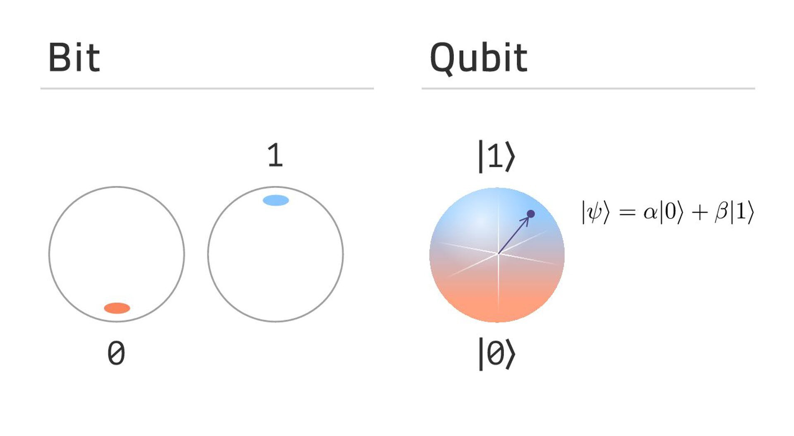
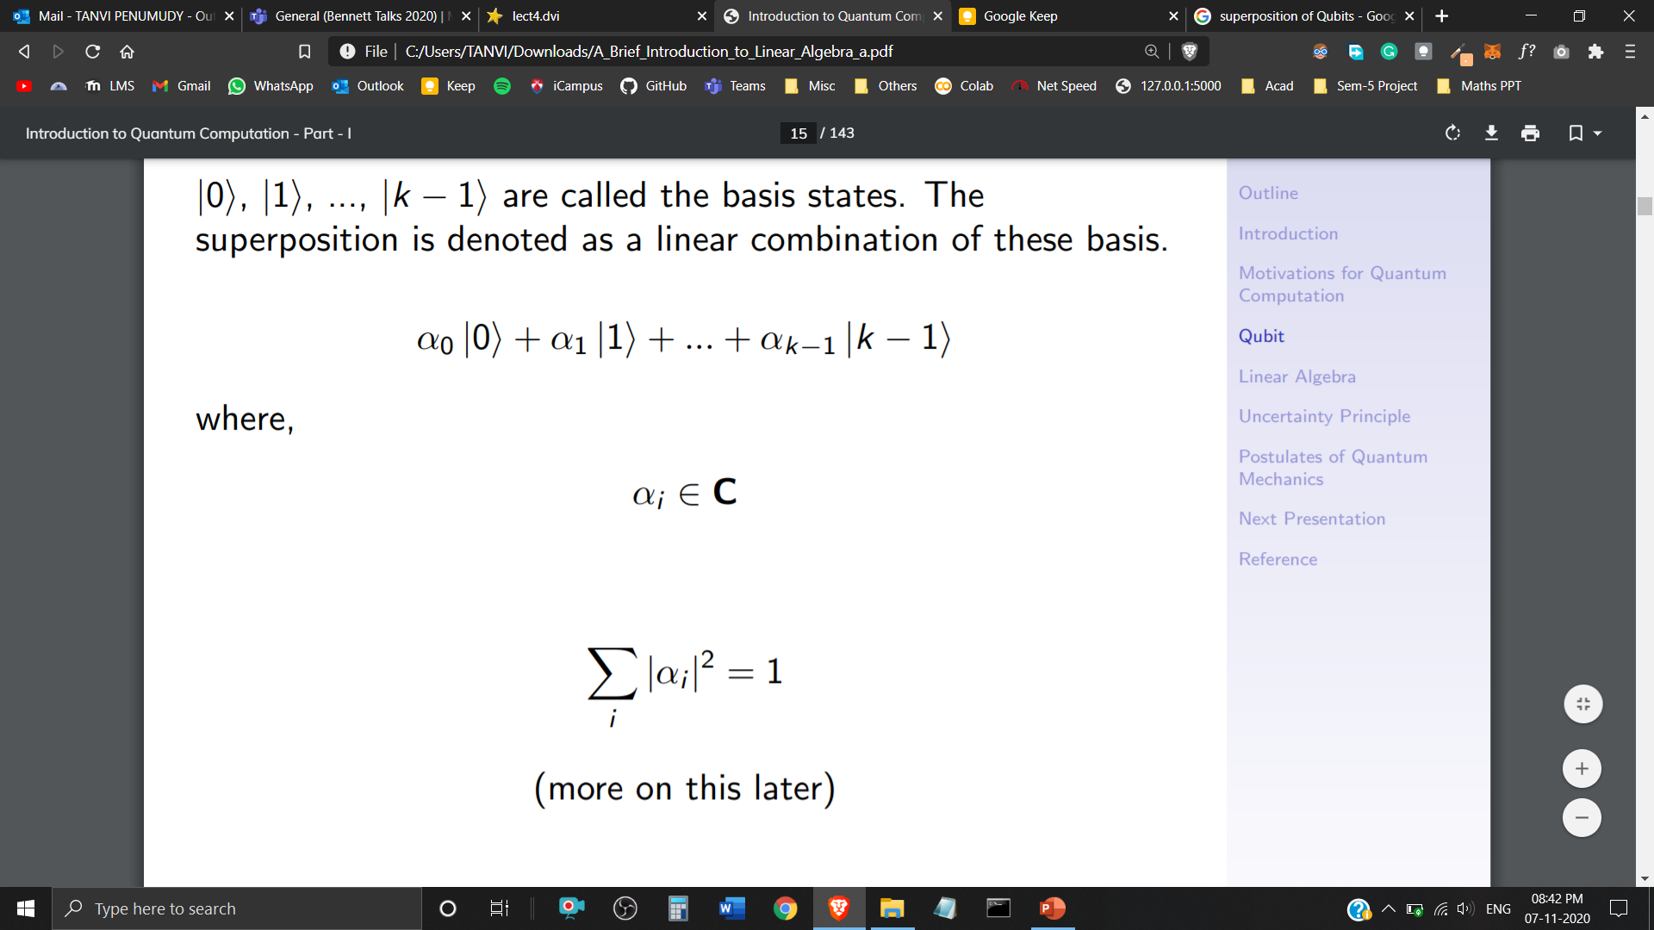
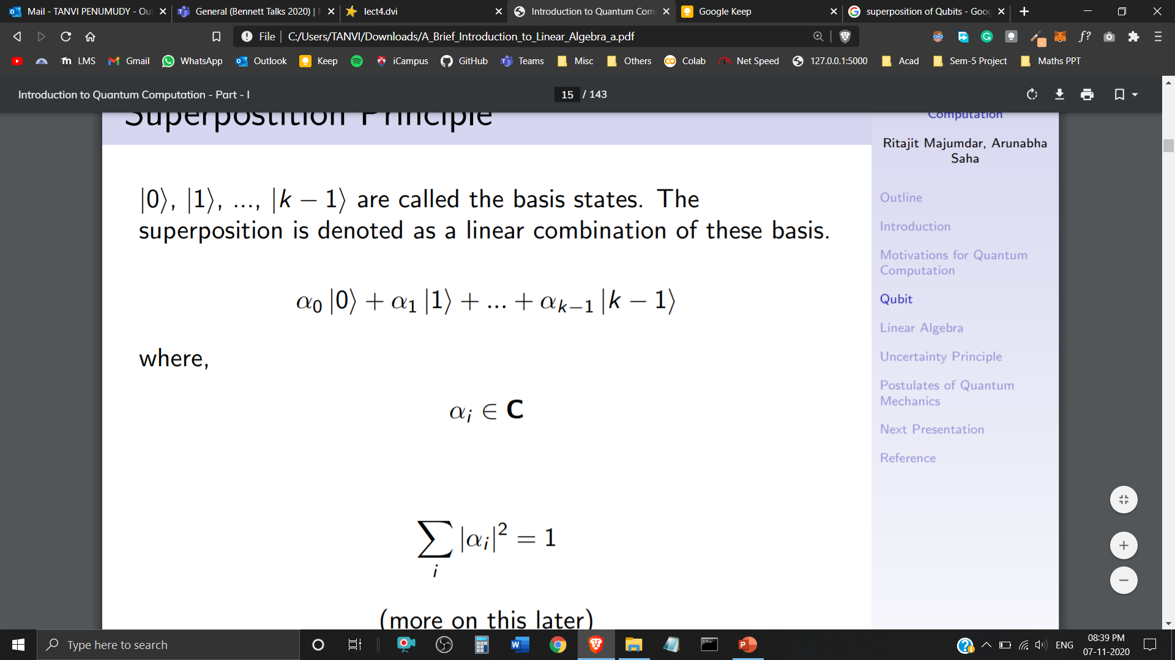
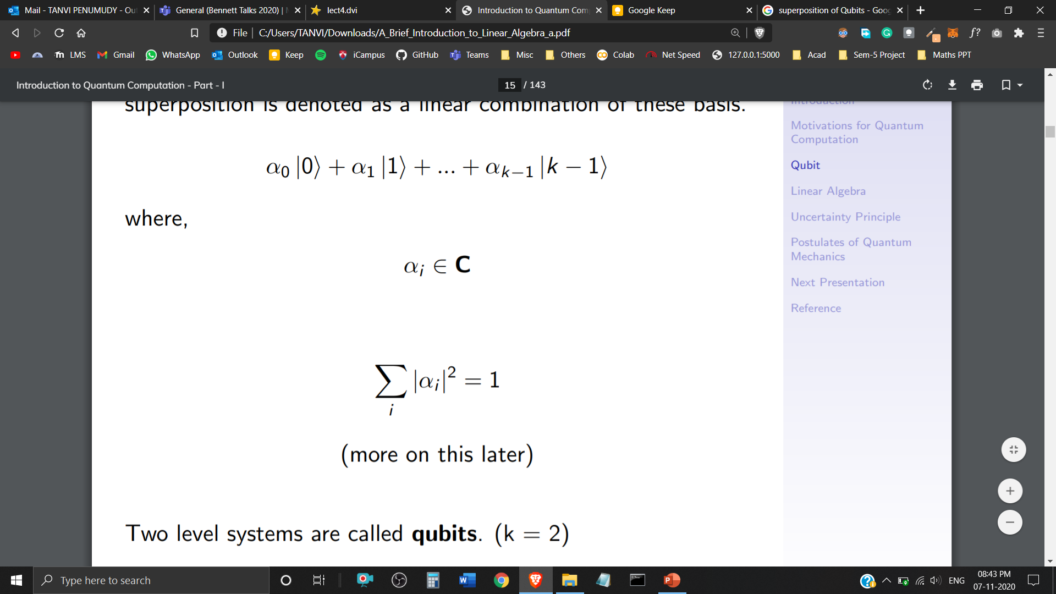

Superposition
In classical computation, bits are either represented with 0 or 1.
In Quantum Computation, these bits are replaced by a superposition of both 0 and 1.
If a quantum system can be in one of k states, it can also be in any linear superposition of those k states.
Two level systems are called Qubits (k=2)
are called the basis states, the superposition is denoted as a linear combination of these basis.
where, and

Slide 4
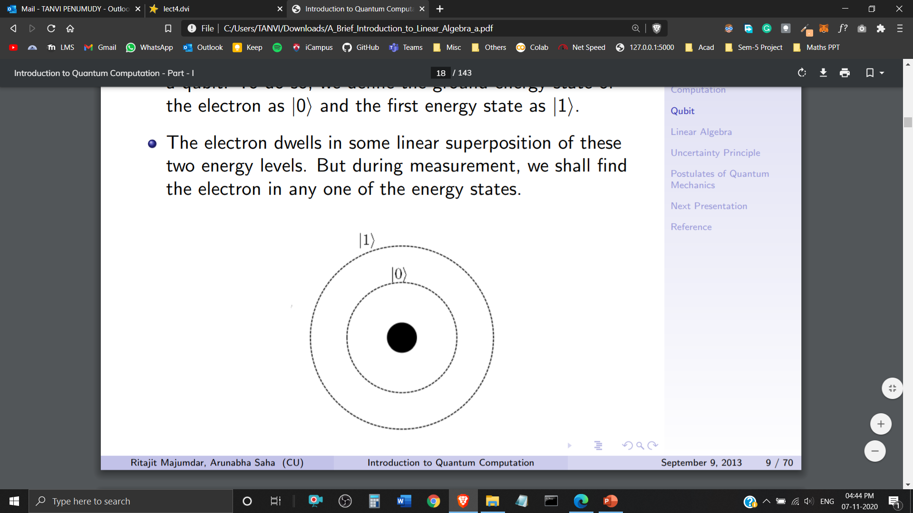
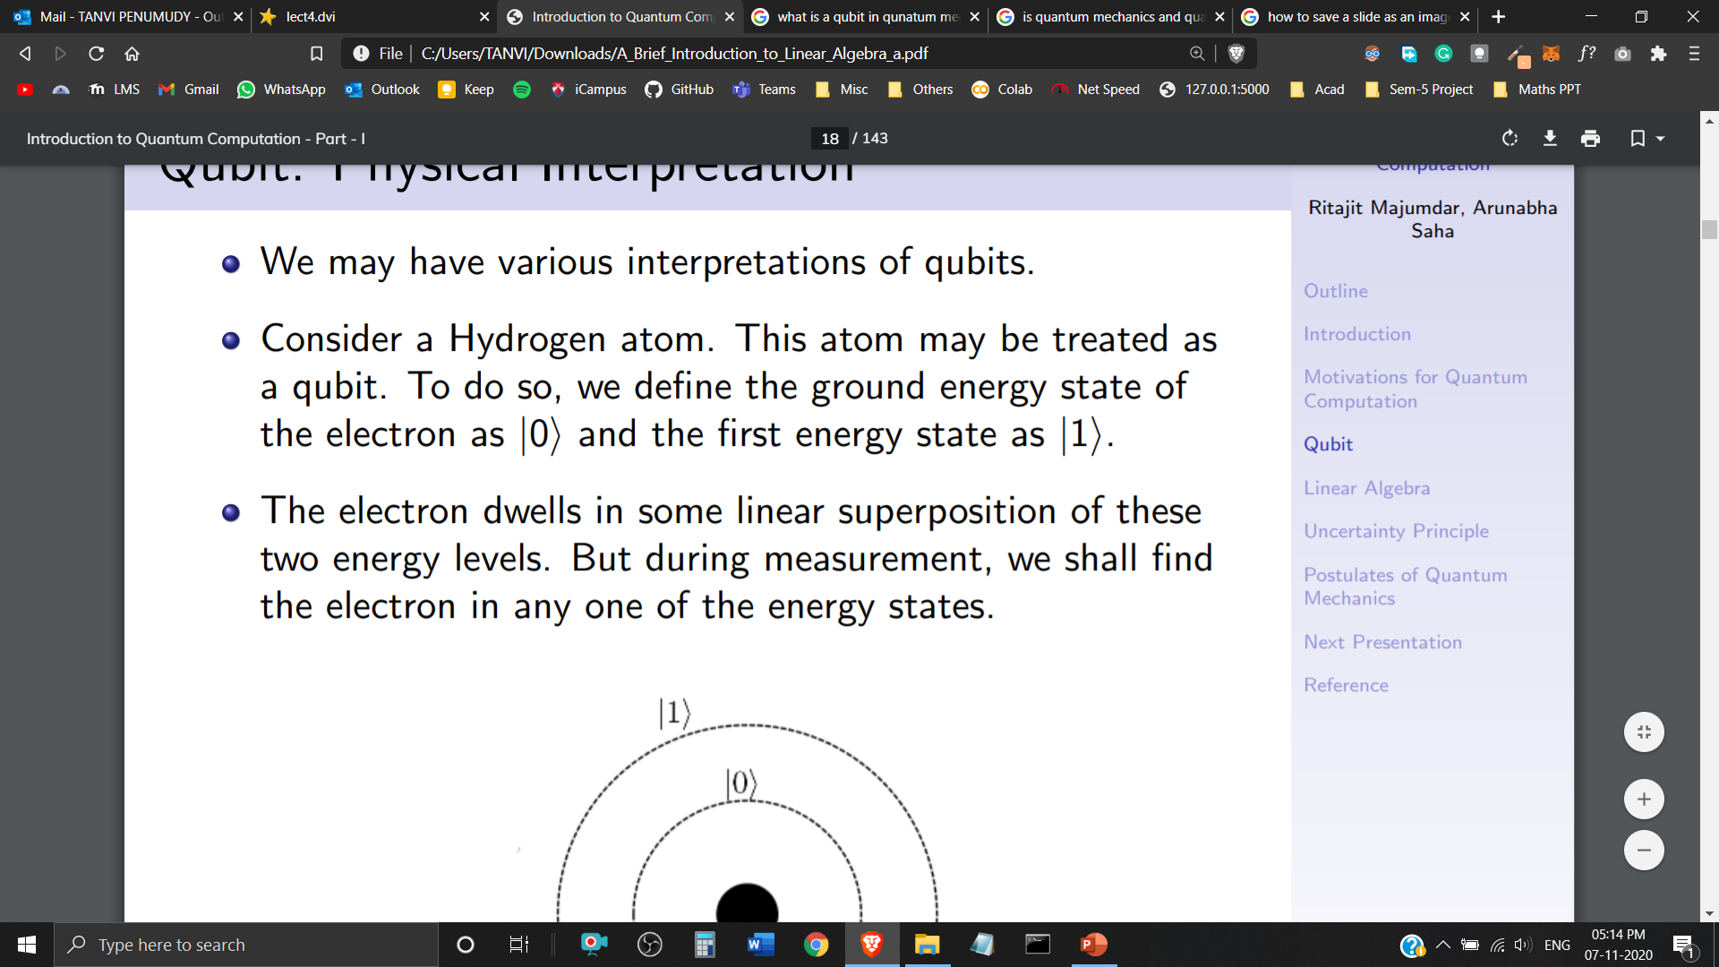
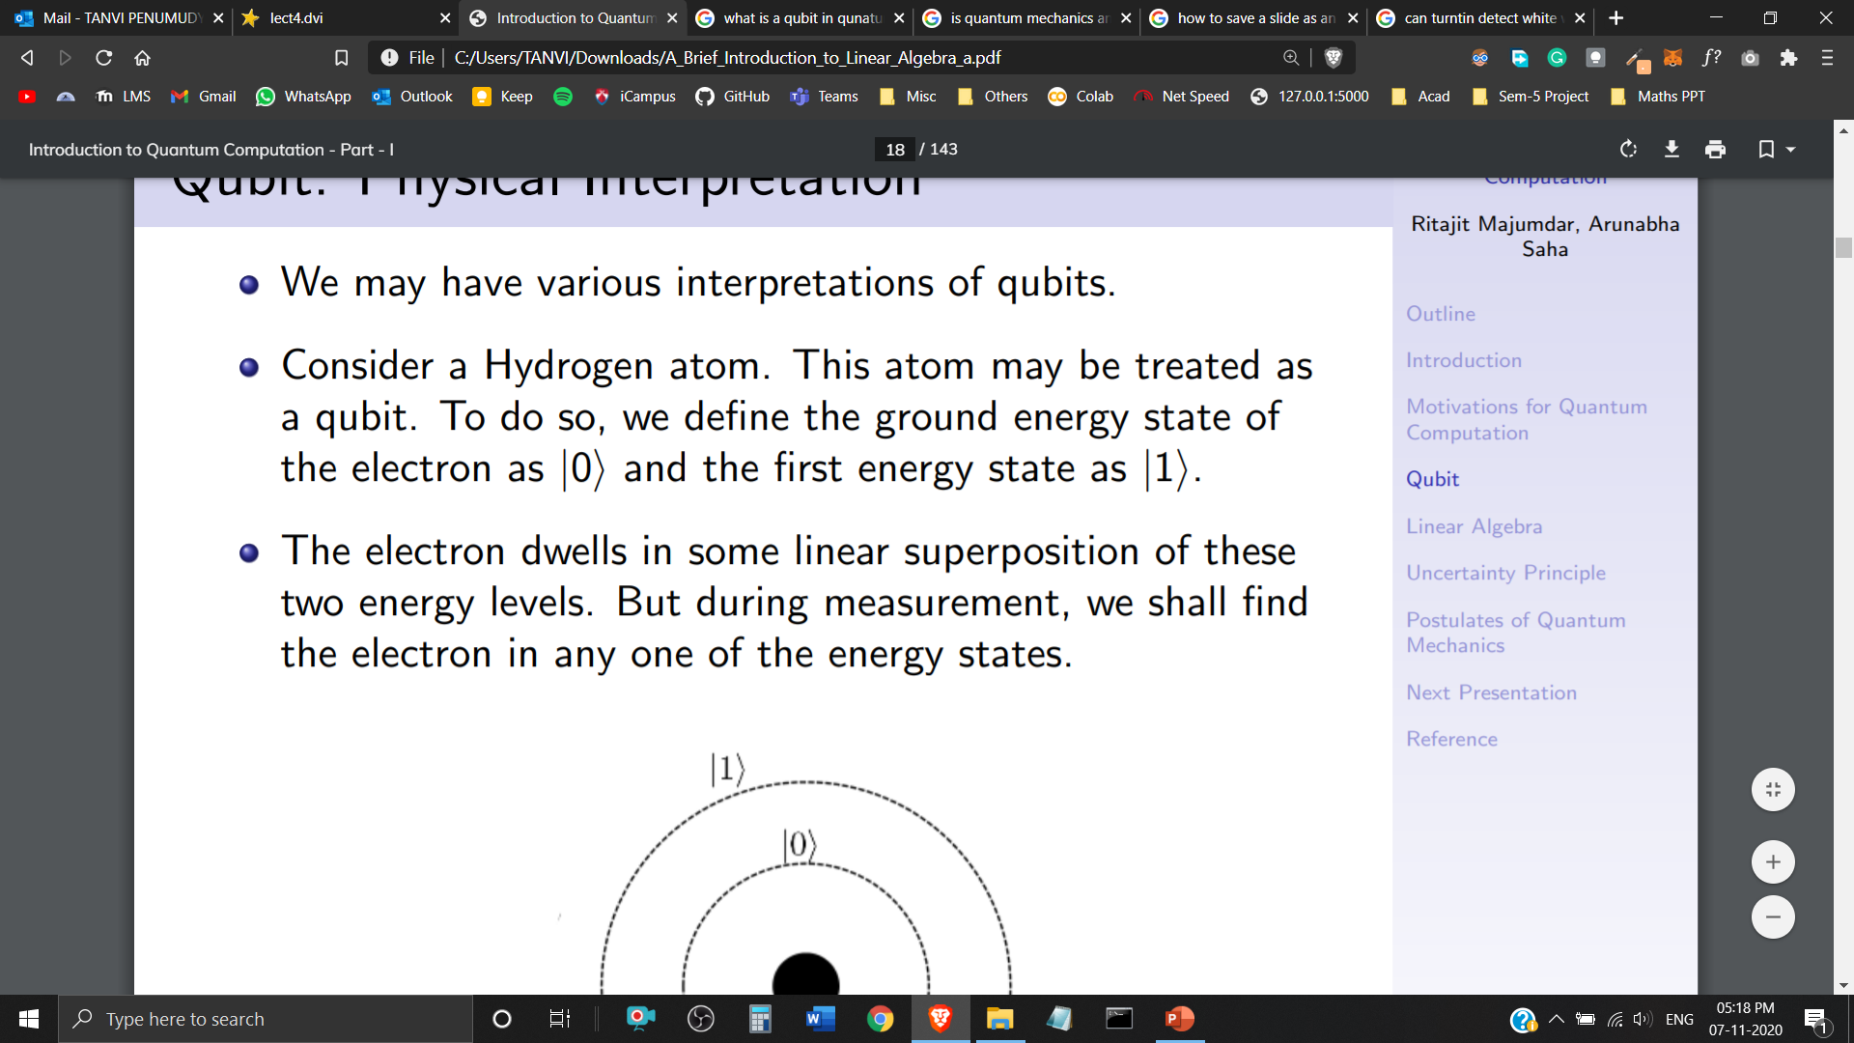
Qubits
A Quantum Bit or a ‘Qubit’ is a building block or a basic unit of Quantum Information.
We have various physical interpretations of a Qubit in Quantum Mechanics.
A Hydrogen atom could be interpreted as a Qubit. An electron in its ground state, could be represented as and in its first energy state as .
The electron dwells in some linear superposition of these two energy levels. But during measurement, it can only be found in one of these energy states.
Hydrogen Atom

Slide 5
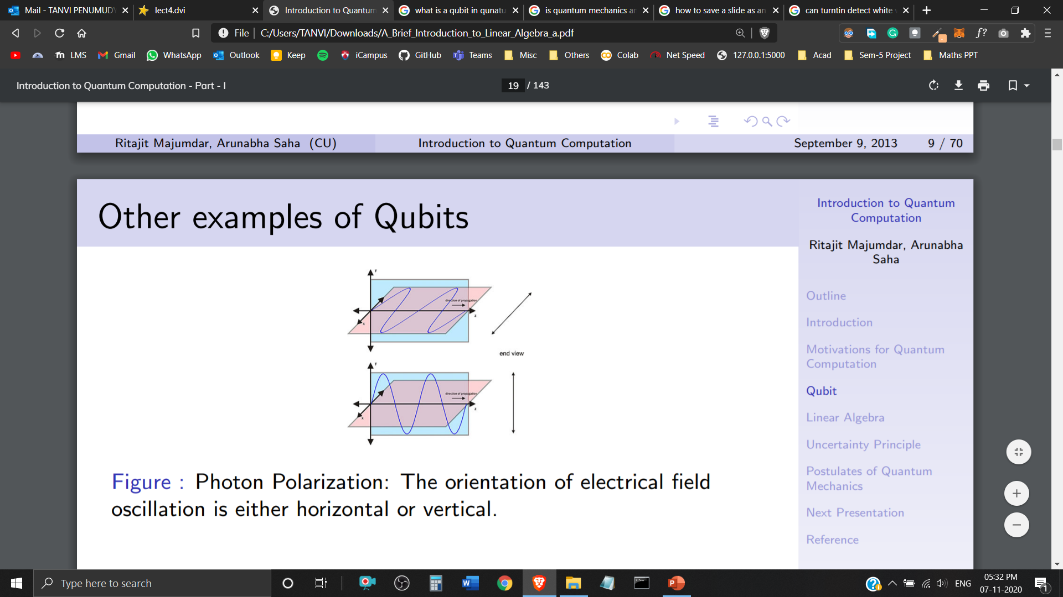
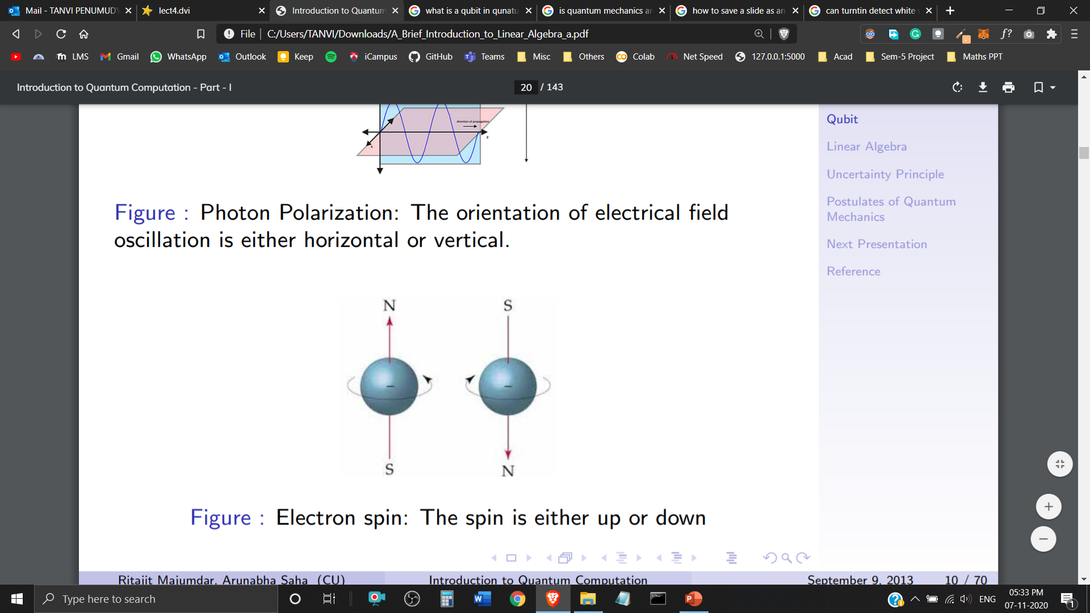
Examples of Qubits
Photon Polarization: The orientation of electrical field oscillation is either horizontal or vertical.
Electron Spin: The electron spin is either up (+1/2) or down (-1/2).

Slide 6
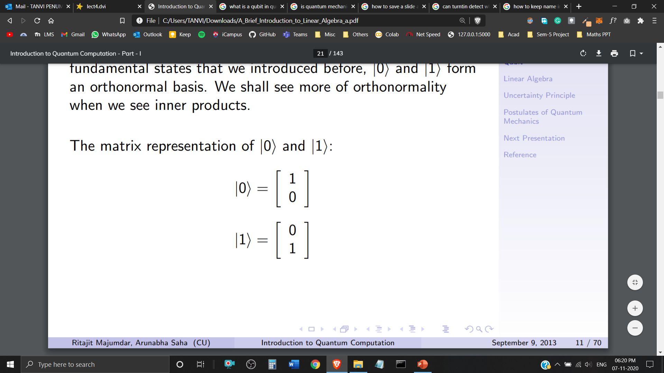
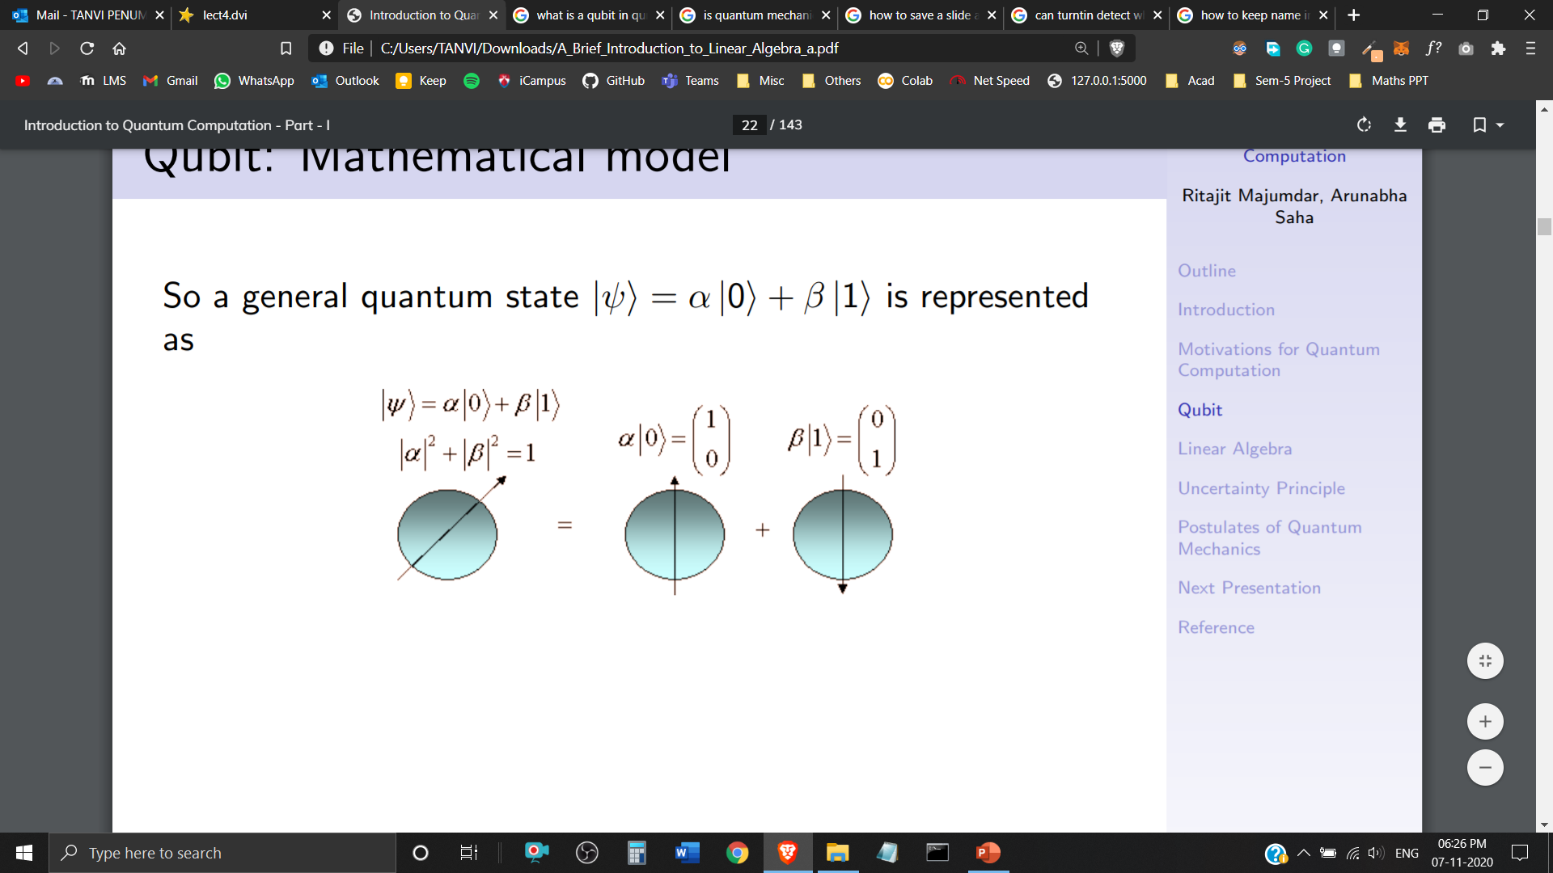
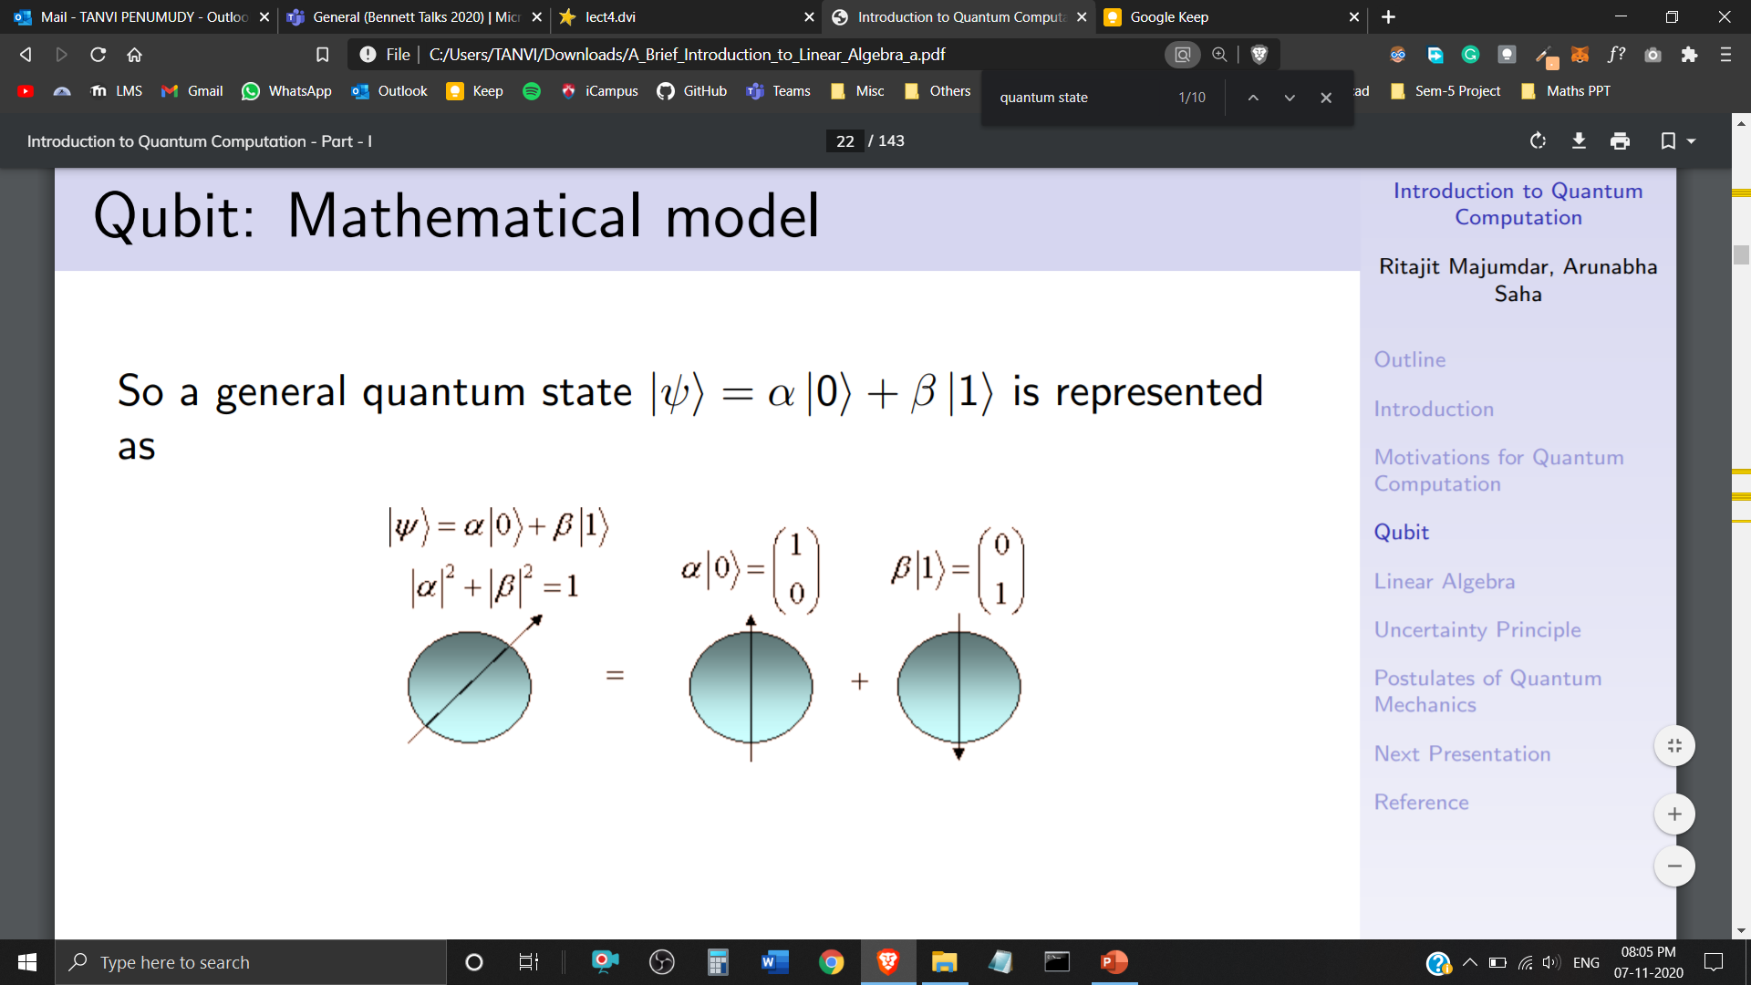
Representation of Qubits
Matrix Representation of and
Representation of a General Quantum State:

Slide 7
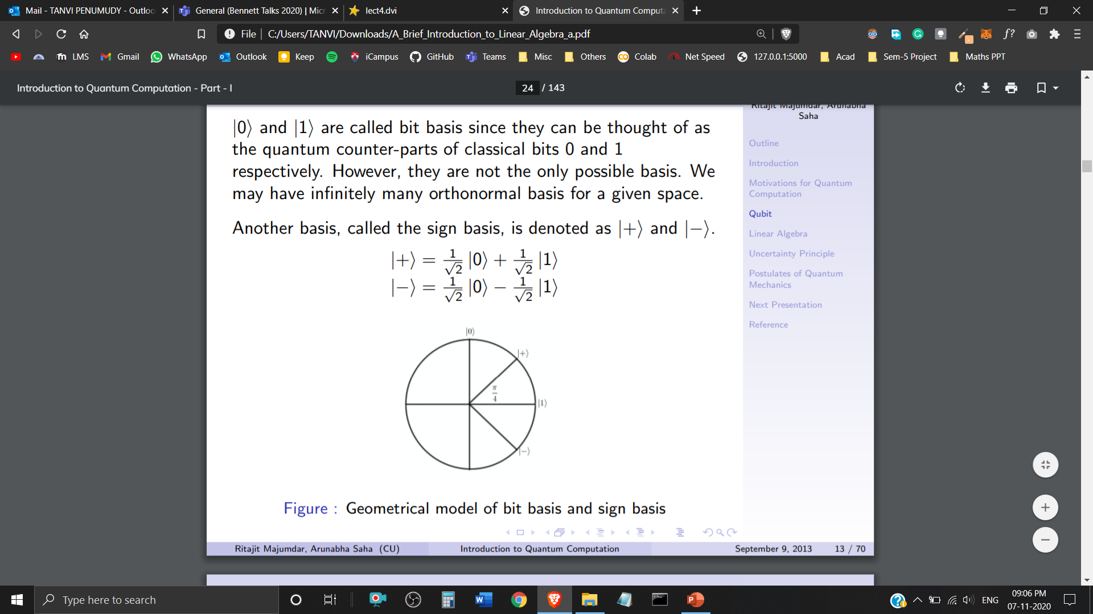
Sign Basis
and are called the bit basis. However, they aren’t the only possible basis.
We can have infinitely many orthonormal basis for a given space.
Another basis, called the sign basis is denoted as and
Geometrical Representation of Basis

Slide 8
Vector Spaces in Quantum Mechanics

Slide 9
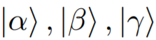
Vector Space
A Vector Space consists of Quantum States (Vectors) – together with a set of Scalars – a, b, c (belonging to Complex Numbers). It is closed under two operations:
Vector Addition
Scalar Multiplications

Slide 10
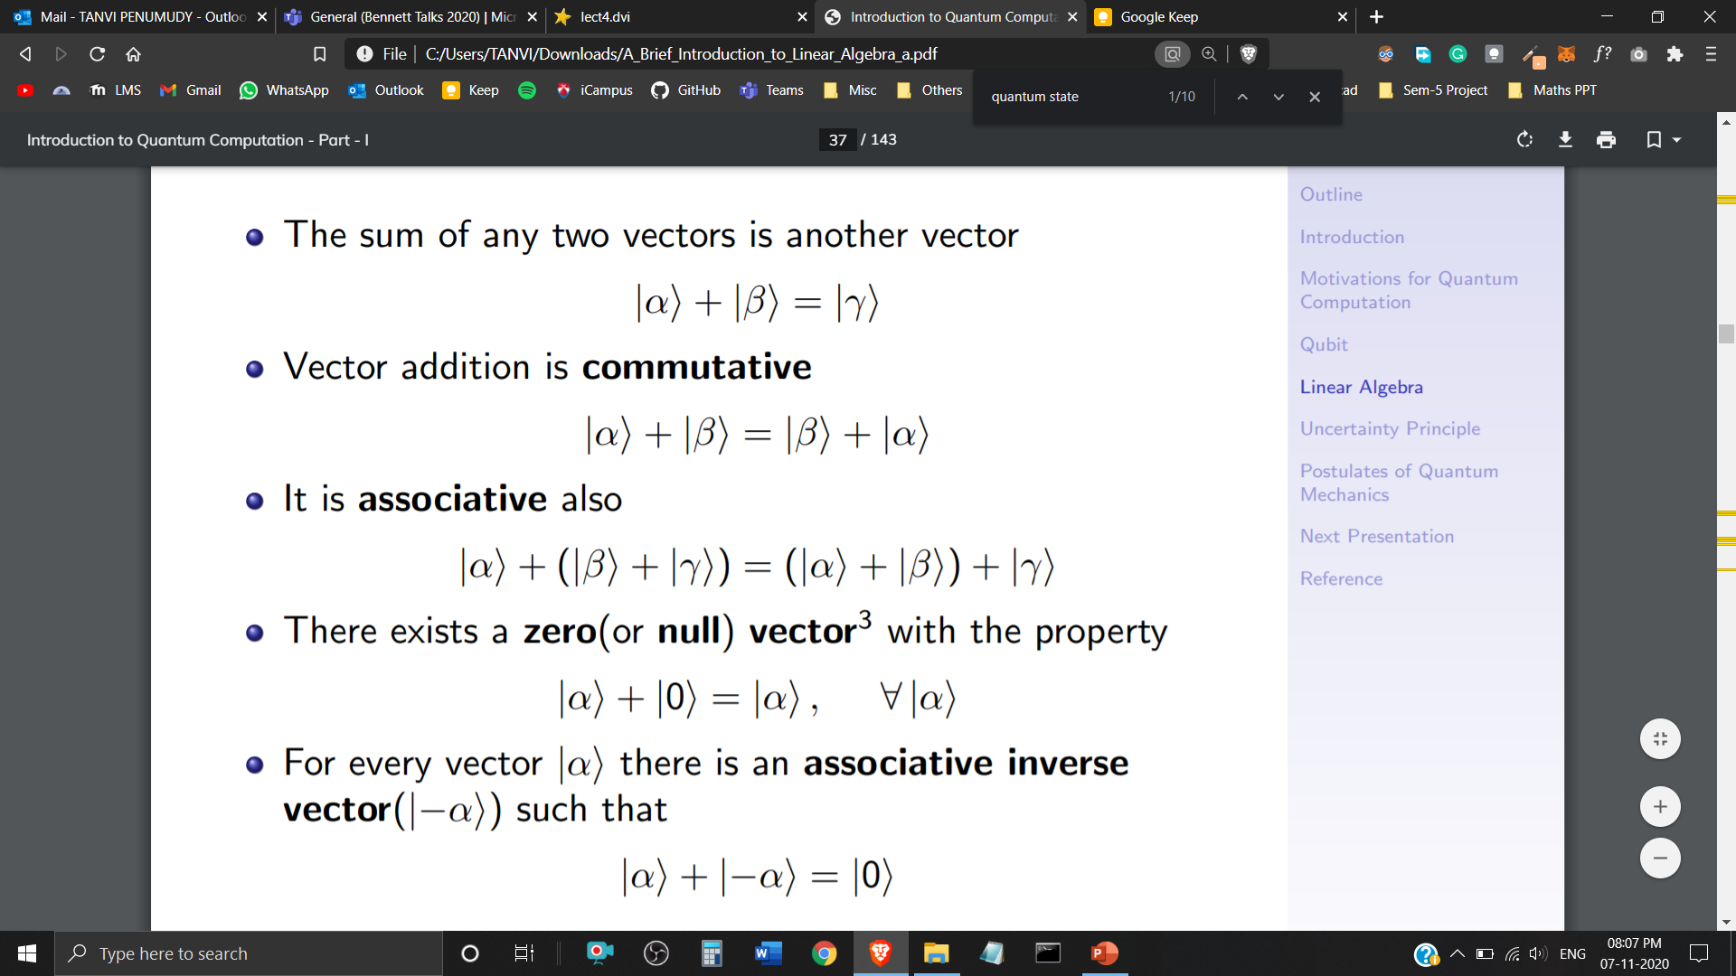
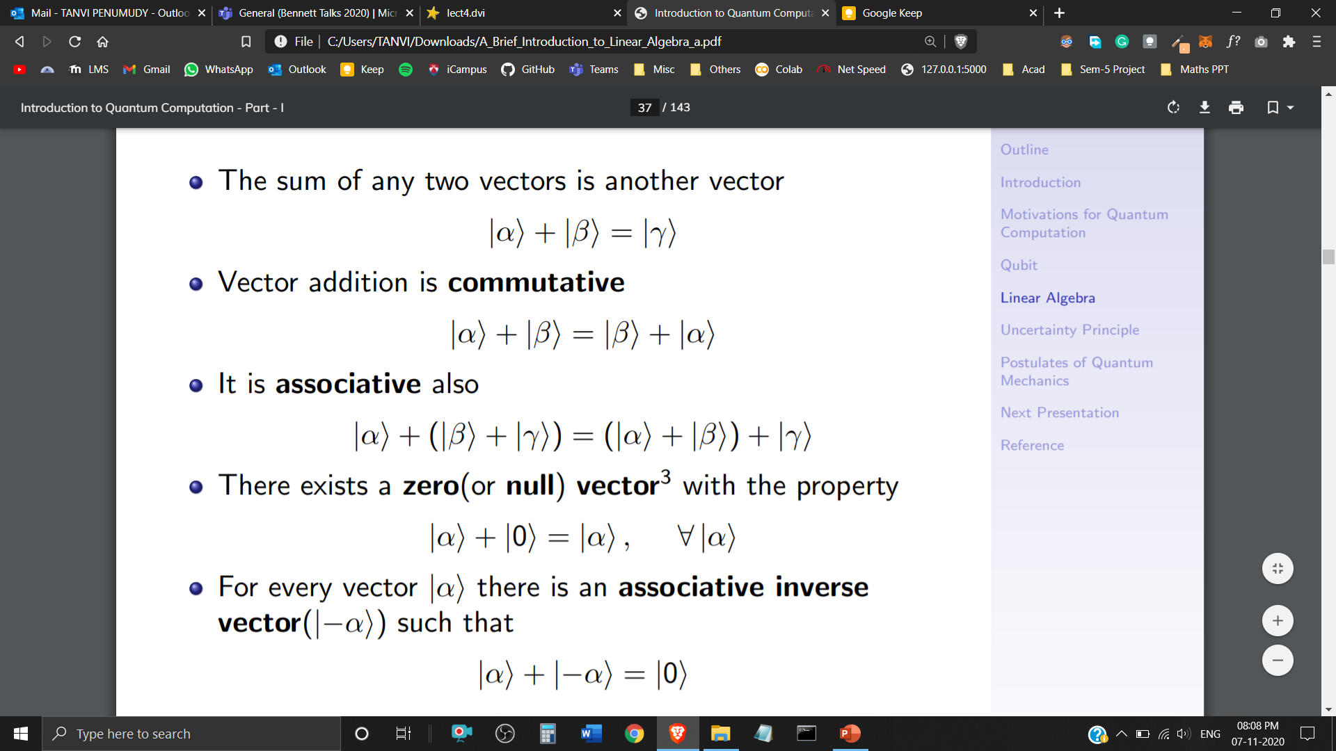
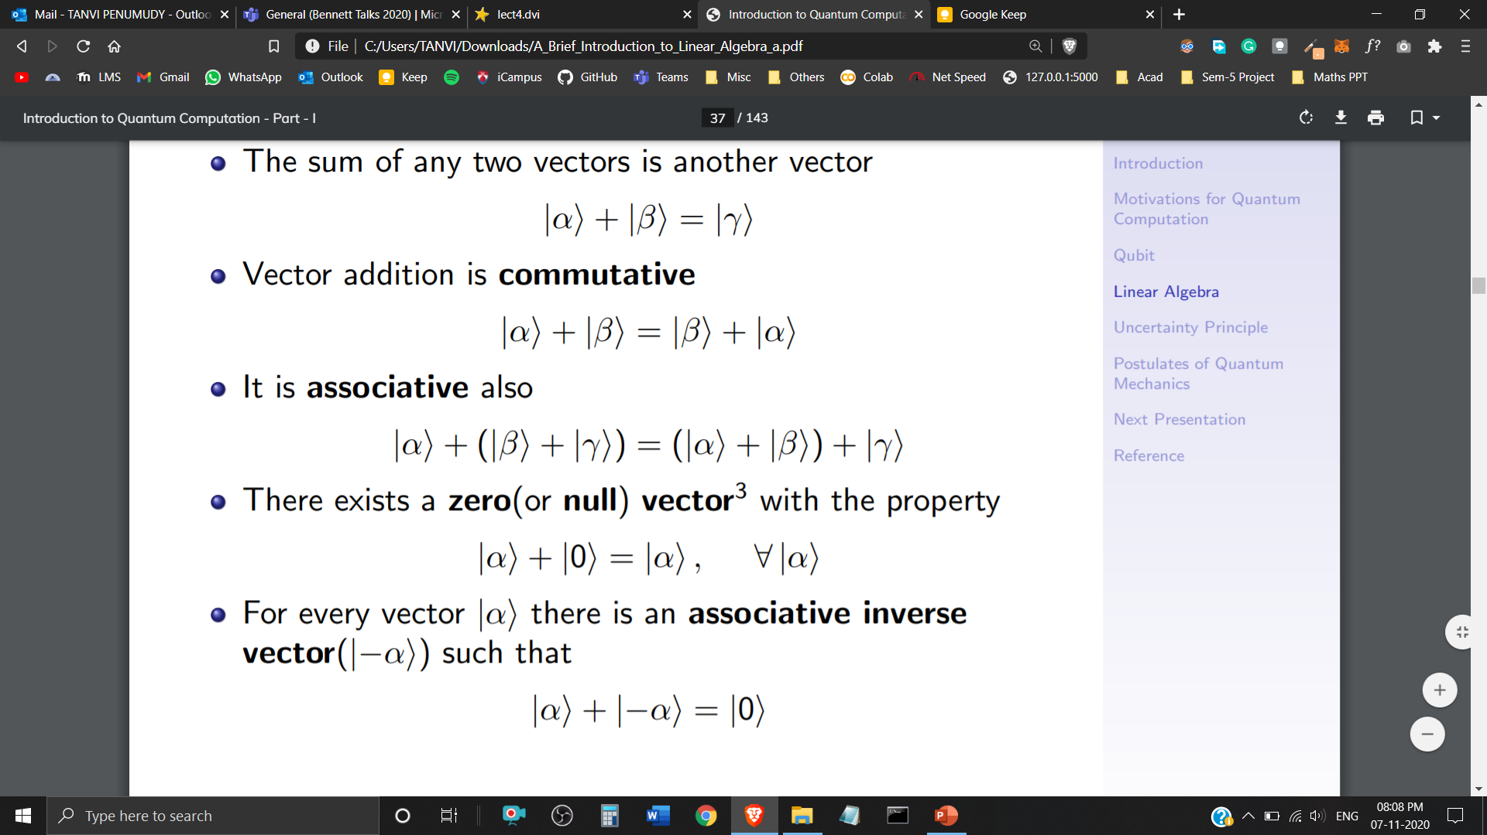
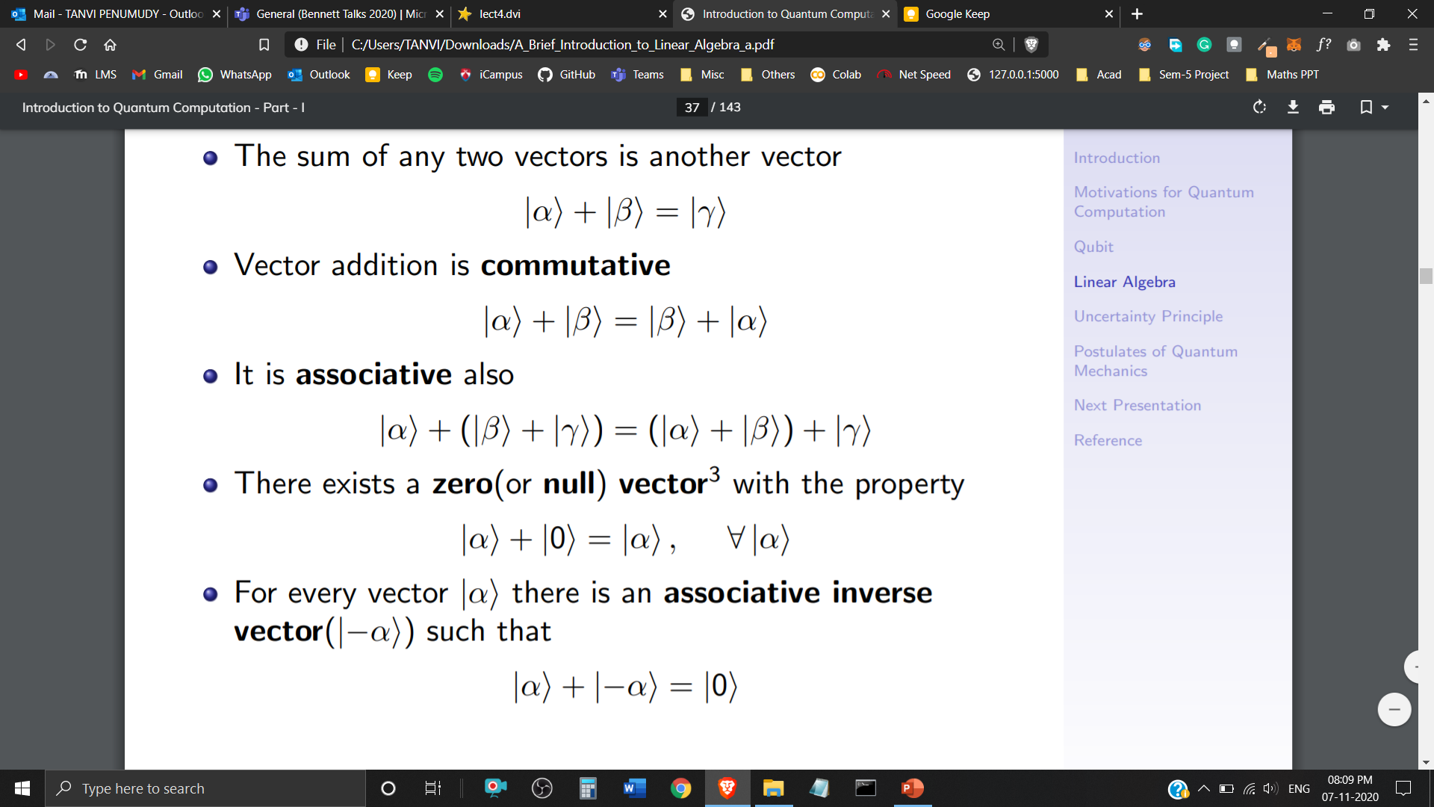

Vector Addition
Closure Property
Commutative Property
Associative Property
Additive Identity
Additive Inverse

Slide 11
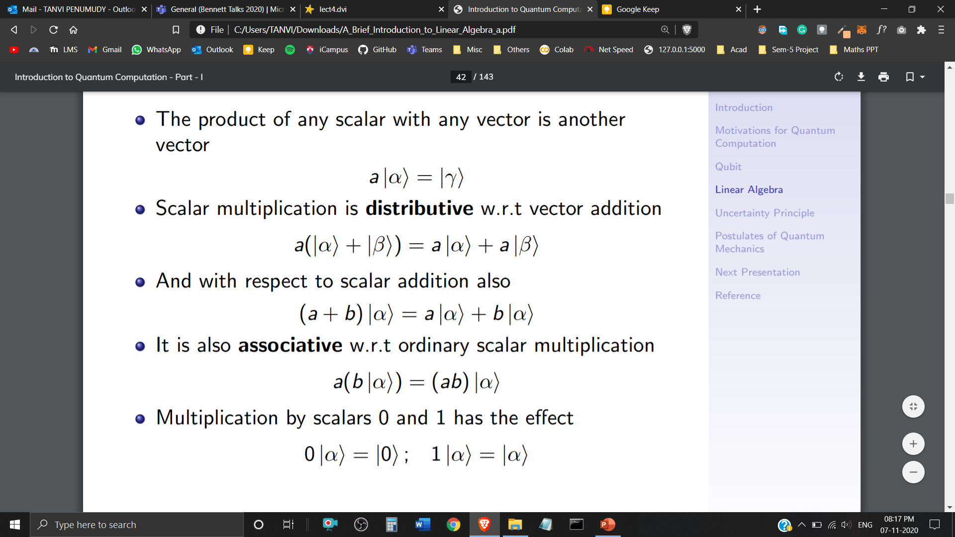



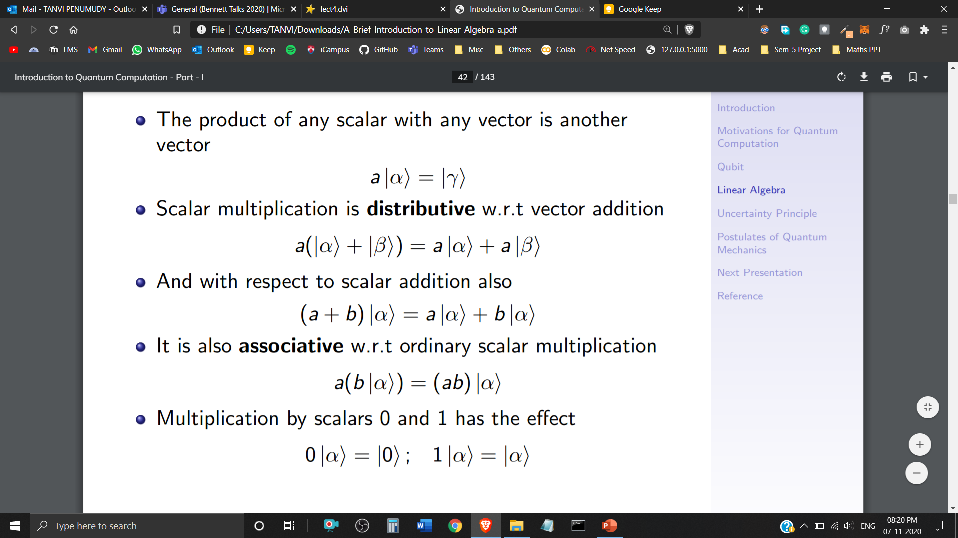
Scalar Multiplication
Closure Property
Distributive w.r.t Vector Addition
Distributive w.r.t Scalar Addition
Associative w.r.t Ordinary Scalar Multiplication
Multiplication with Scalars 0 and 1

Slide 12
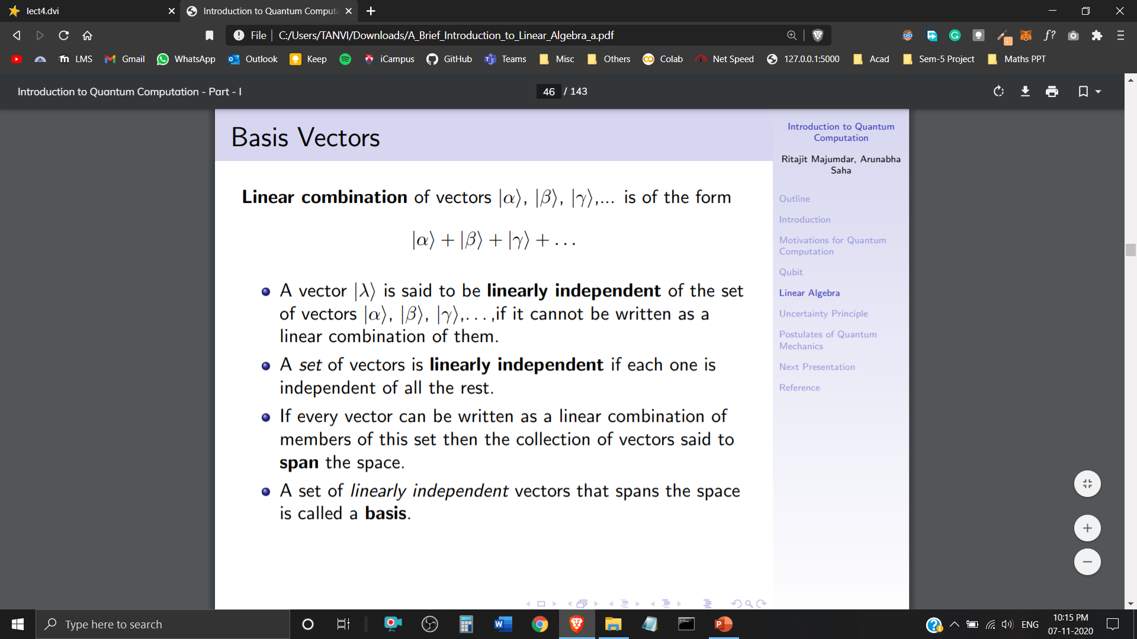

Basis
Linear Combination of Quantum States is in the form of
A Quantum State is said to be linearly independent of the set of Quantum States , if it cannot be written as a Linear Combination of them.
If every Quantum State can be written as a Linear Combination of this set then the collection of Quantum States said to Span the space.
A set of Linearly Independent Quantum States that span the space is called a Basis.

Slide 13
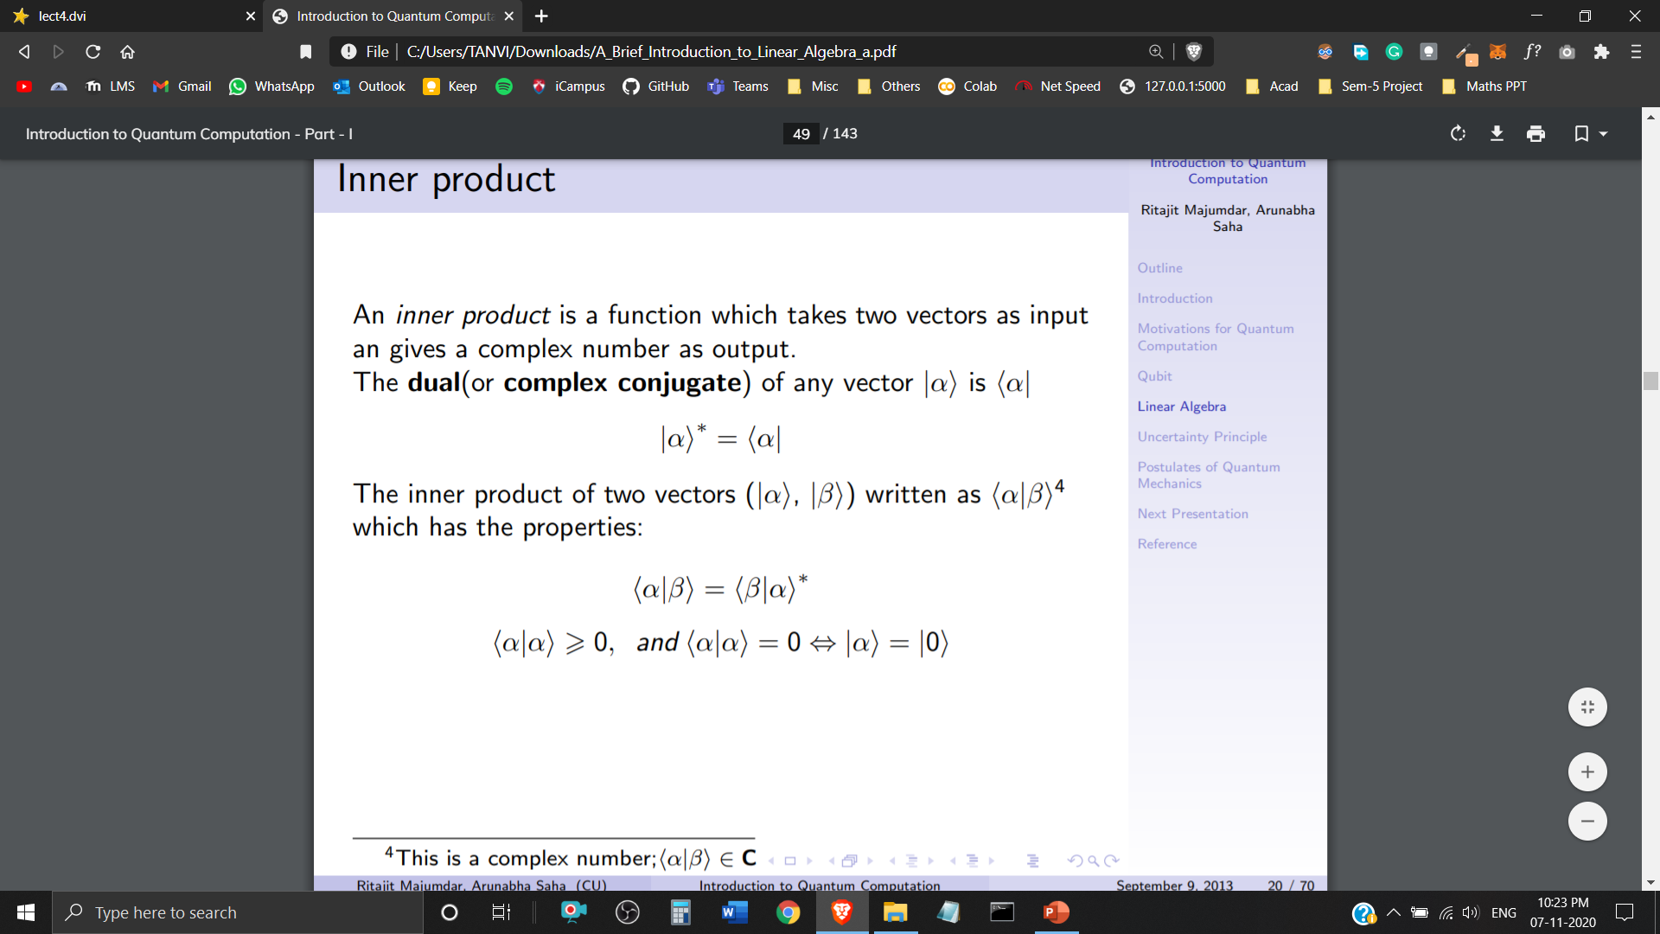
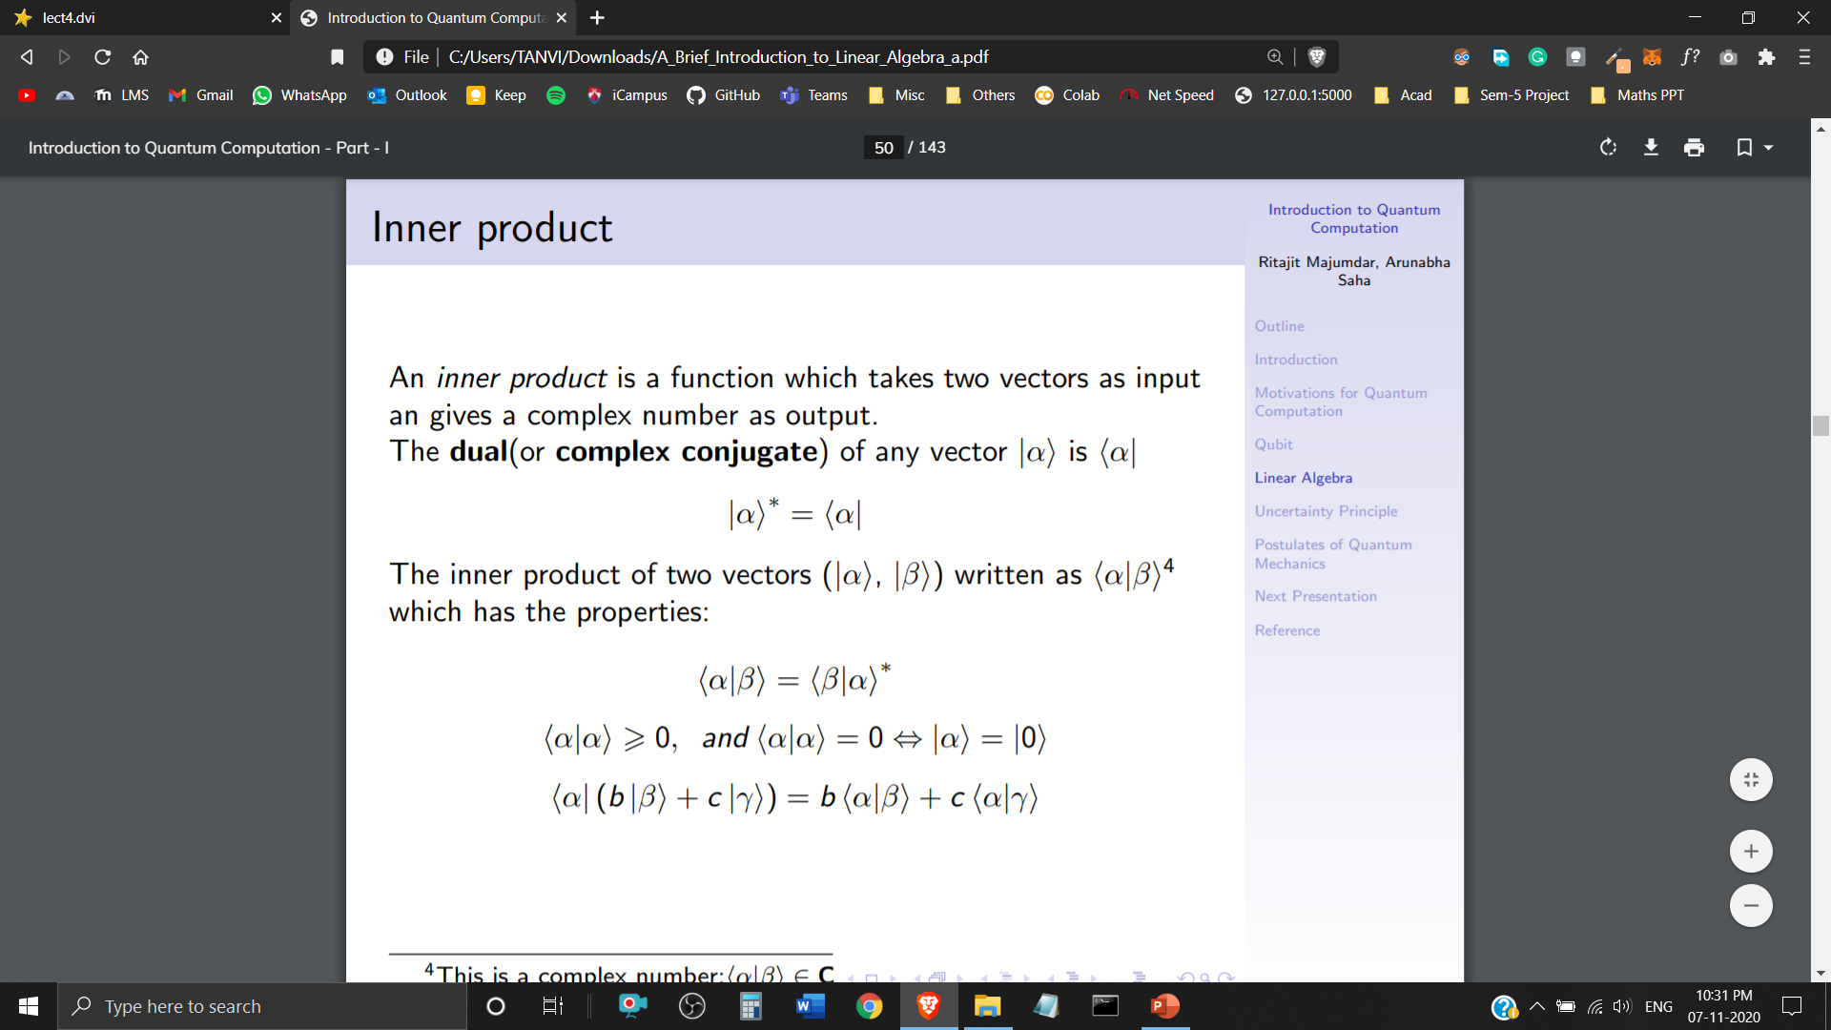

Inner Product
An inner product is a function which takes two Quantum States as input and gives a Complex Number as output.
The Dual (or Complex Conjugate) of any Quantum State (ket notation) is ((bra notation)
The inner product of two Quantum States is written as

Slide 14
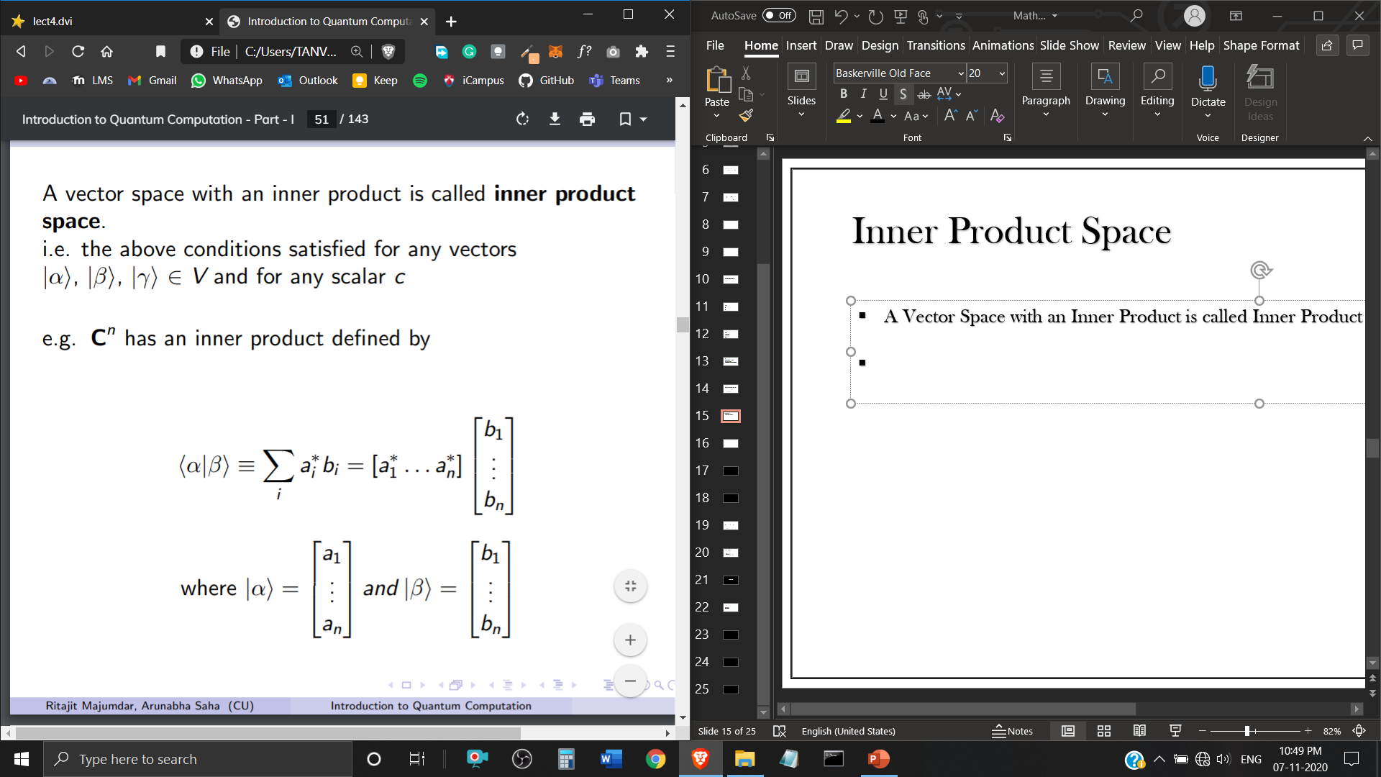
Inner Product Space
A Vector Space with an Inner Product is called Inner Product Space.
has an inner product defined by
where,

Slide 15
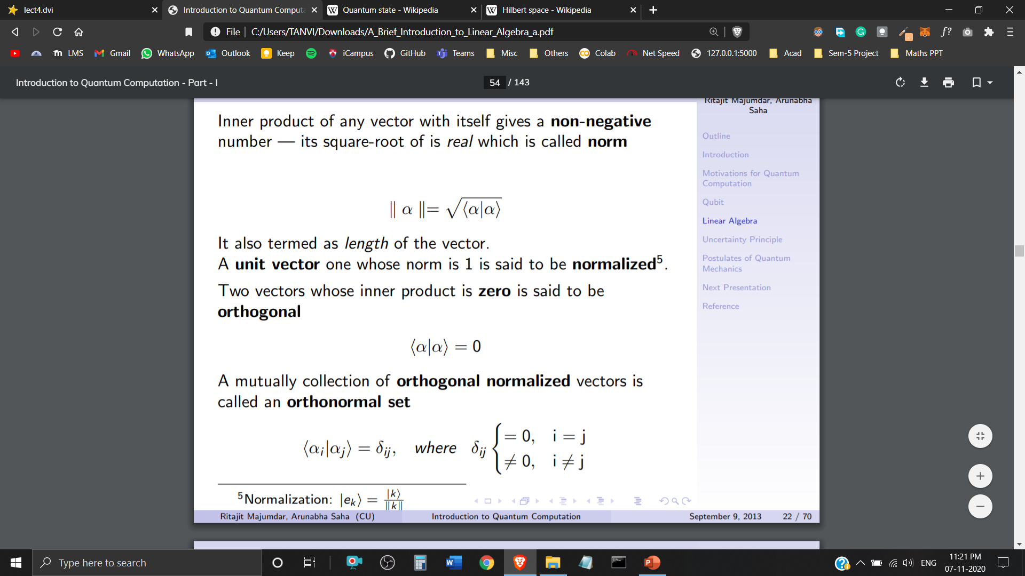
Orthonormal Set
Inner product of any Quantum State with itself gives a Non-negative number – its square root of id real which is called norm. (Also termed as Vector Length)
A Quantum State with Norm 1 (Unit Vector) is said to be Normalized.
Two Quantum States with Inner Product zero are said to be Orthogonal.
A Mutual Collection of Orthogonal Normalized Quantum States is called an Orthonormal Set.

Slide 16
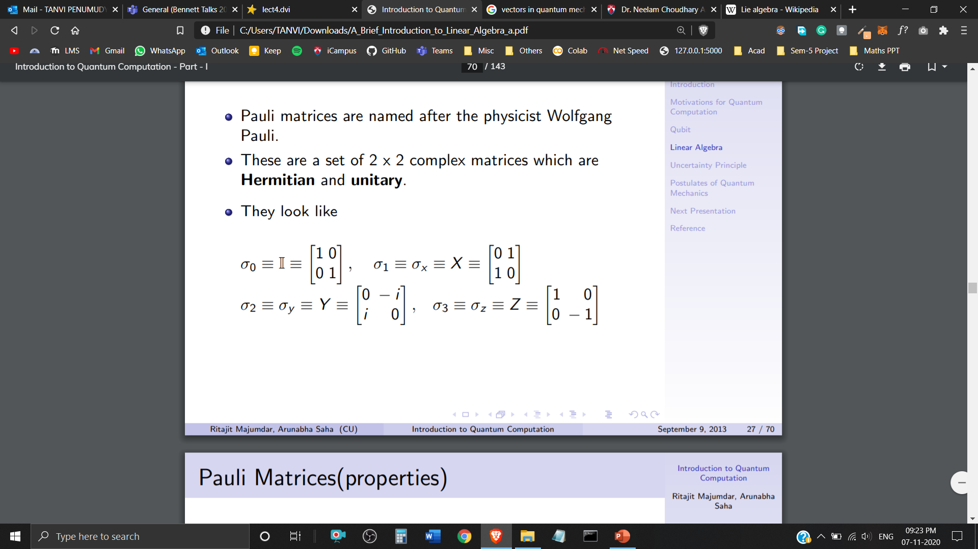
Pauli Matrices
Pauli Matrices are named after the physicist Wolfgang Pauli.
These are a set of 2 x 2 complex matrices which are Hermitian and Unitary.

Slide 17
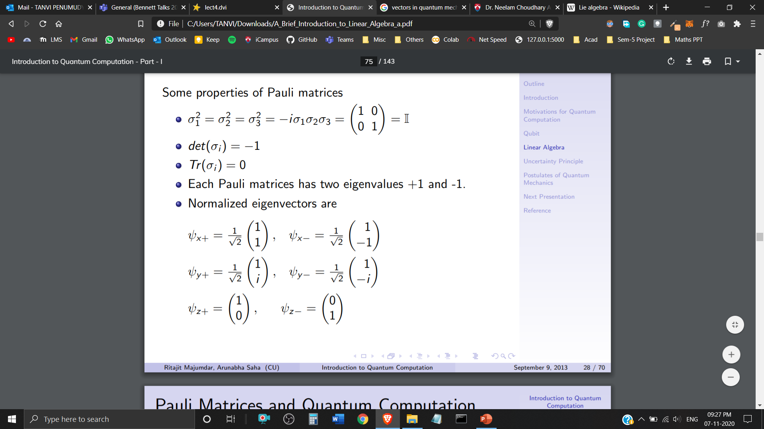
Properties of Pauli Matrices
Each Pauli Matrix has eigenvalues +1 and -1
Normalised Eigenvectors are

Slide 18
Hilbert Space
Wave functions exist in the Hilbert Space

Slide 19
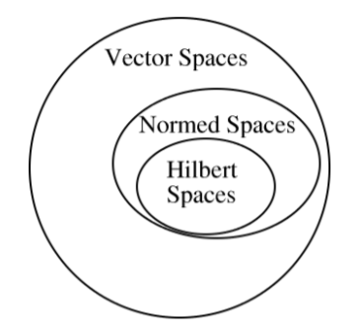
Hilbert Space
The Mathematical Concept of Hilbert Space has been named after David Hilbert.
Hilbert Space is an abstract vector space with inner product defined in it, that allow the length and angle to be measured.
Hilbert Space must be complete.
Infinite Dimensional Inner Product Space

Slide 20
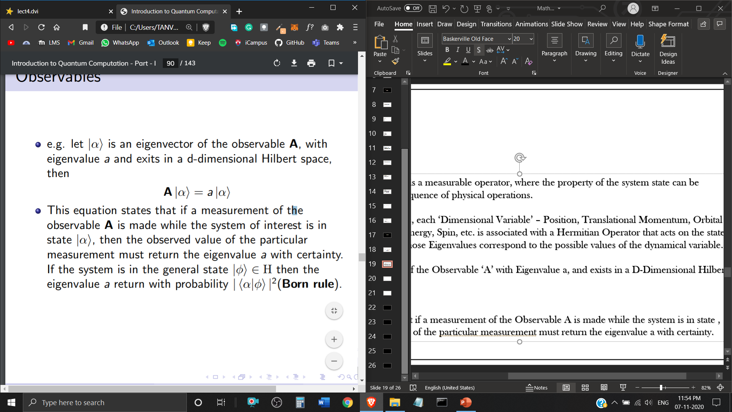
Observables
A System ‘Observable’ is a measurable operator, where the property of the system state can be determined by some sequence of physical operations.
In Quantum Mechanics, each ‘Dimensional Variable’ – Position, Translational Momentum, Orbital Angular Momentum, Energy, Spin, etc. is associated with a Hermitian Operator that acts on the state of the quantum system, whose Eigenvalues correspond to the possible values of the dynamical variable.
Let be an Eigenvector of the Observable ‘A’ with Eigenvalue a, and exists in a D-Dimensional Hilbert Space, then
This equation states that if a measurement of the Observable A is made while the system is in Quantum State, then the observed value of that measurement must return the eigenvalue a with certainty.

Slide 21
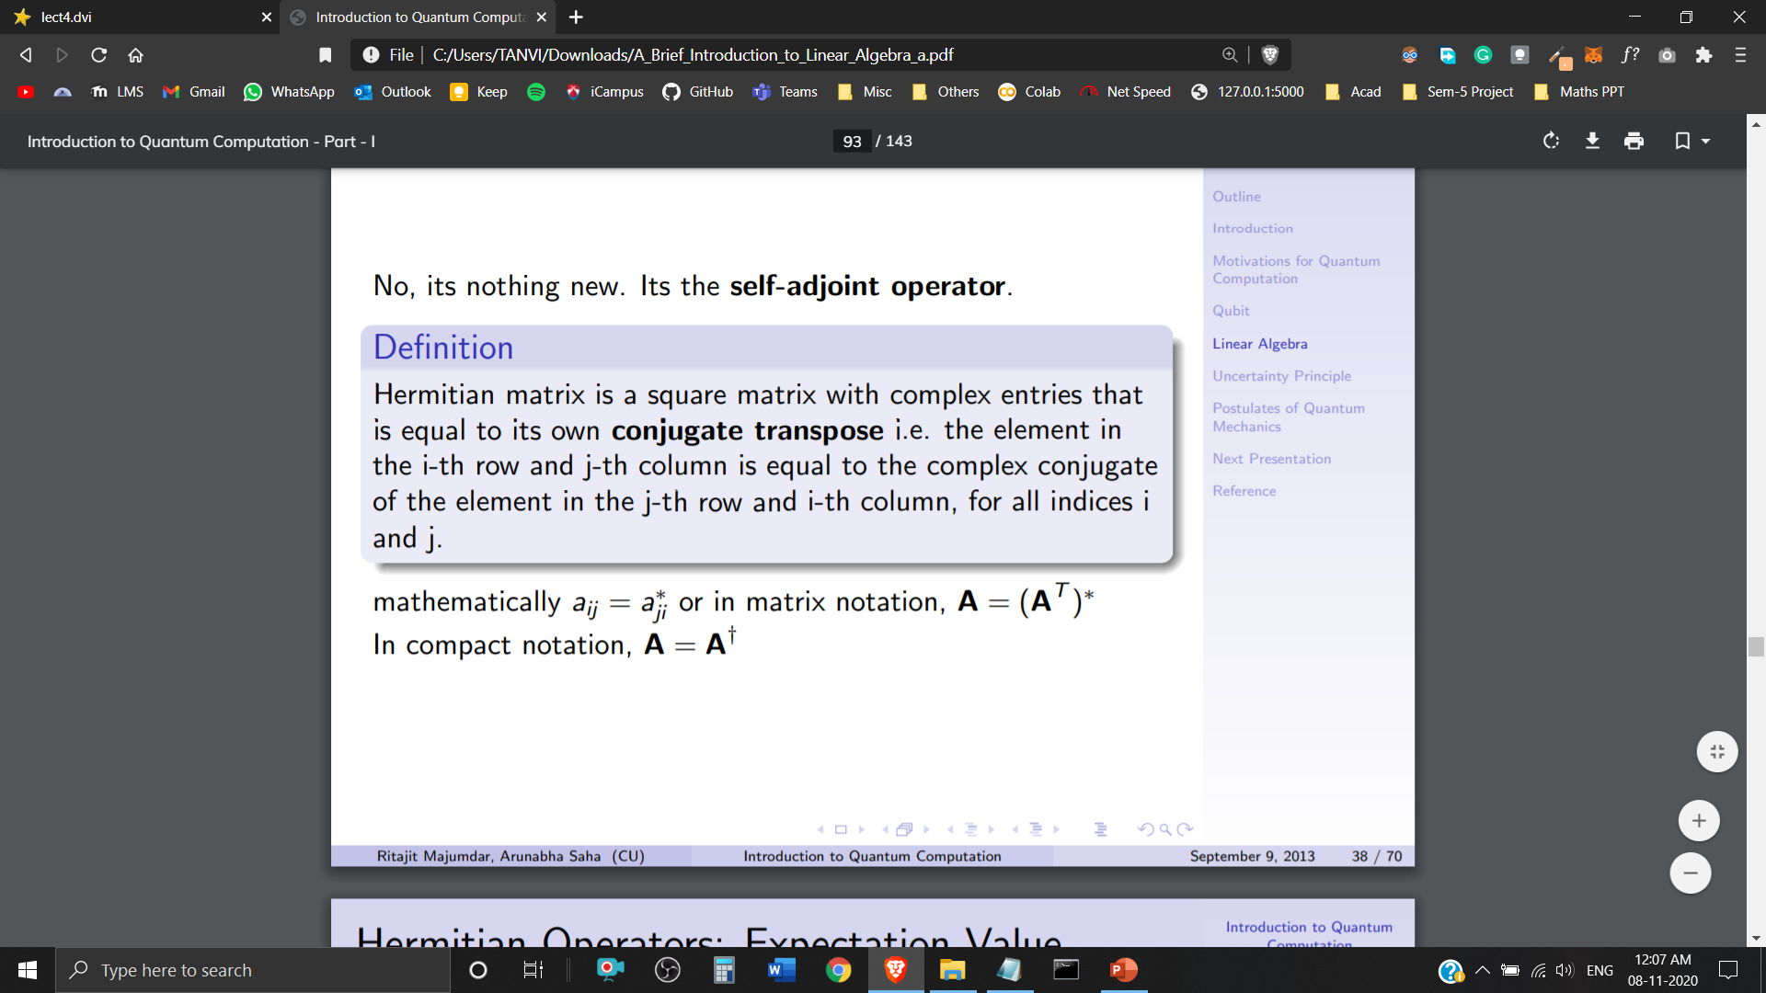
Hermitian Operator
Self-Adjoint Operator
Hermitian matrix is a square matrix with complex entries that is equal to its own conjugate transpose.
or
Eigenvalues of Hermitian operators are real.
Eigenfunctions belonging to distinct eigenvalues are orthogonal.
The eigenfunctions of a Hermitian operator is complete.
Any function (in Hilbert space) can be expressed as the linear combination of them

Slide 22
Postulates of
Quantum Mechanics

Slide 23
1st Postulate: State Space
Associated to any isolated system is a Hilbert Space called the state space. The system is completely defined by the state vector, which is a unit vector in the state space.

Slide 24
2nd Postulate: Evolution
Associated to any isolated system is a Hilbert Space called the state space. The system is completely defined by the state vector, which is a unit vector in the state space.

